Slide 1
Open Library Search API
https://openlibrary.org/dev/docs/api/search
https://openlibrary.org/developers/api
Google Book Embedded Viewer API
https://developers.google.com/books/docs/viewer/developers_guide
https://developers.google.com/books/branding

Slide 2
Find a Book
Title
Author
Submit

Slide 3

11 records found
https://openlibrary.org/search.json?title=the+happiness+project
 | Title | Author | Year | Preview
1 | ABC | XYZ | 2018
2 | ABCD | XYZ | 2017
3 | ABC | XYZ | 2002
4 | ABC DEF | XYZ | 2001
5
6
7

Slide 4
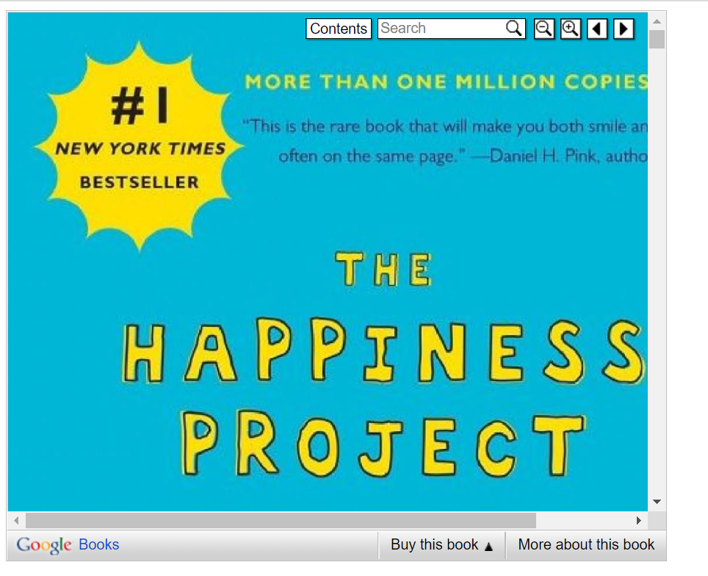

Slide 5
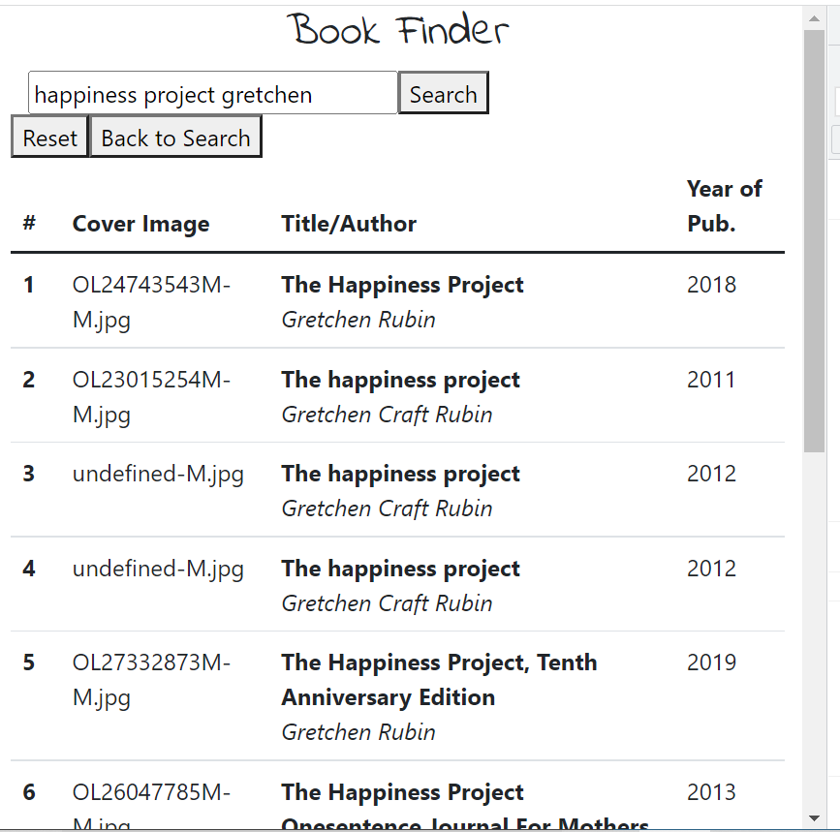

Slide 6
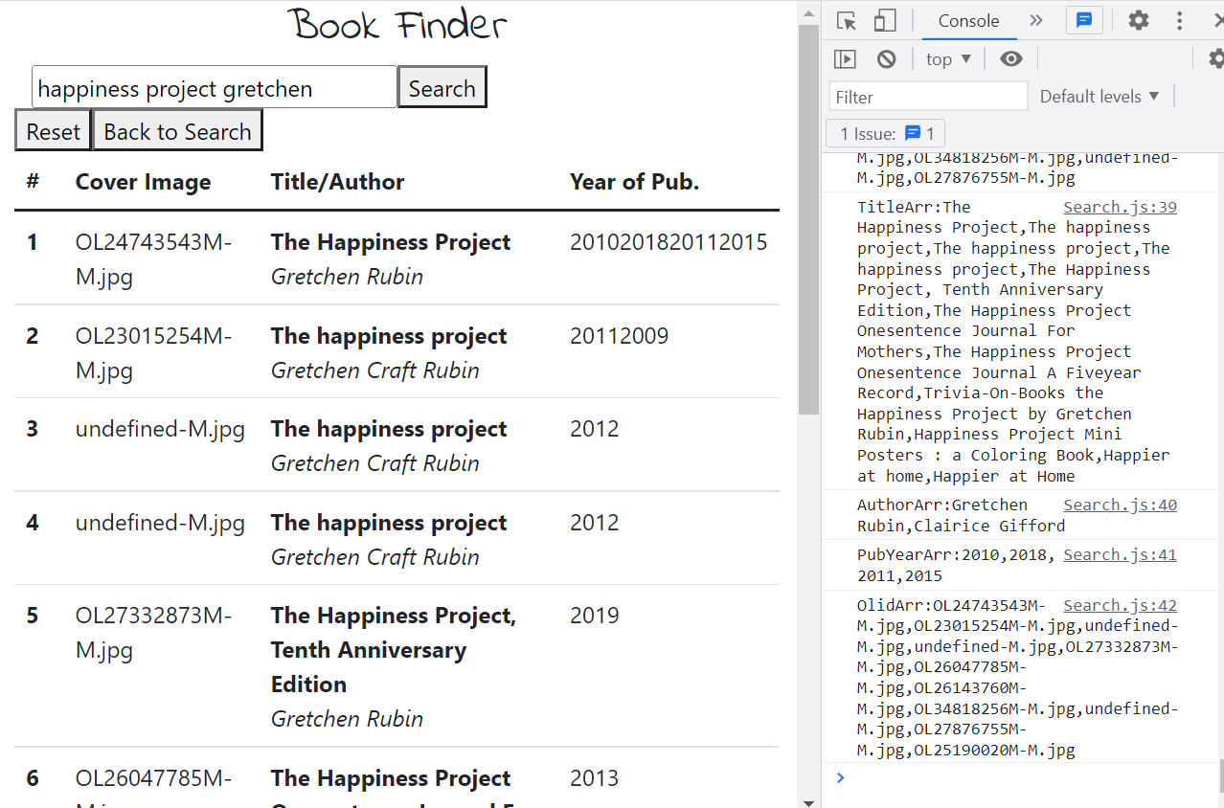

Slide 7
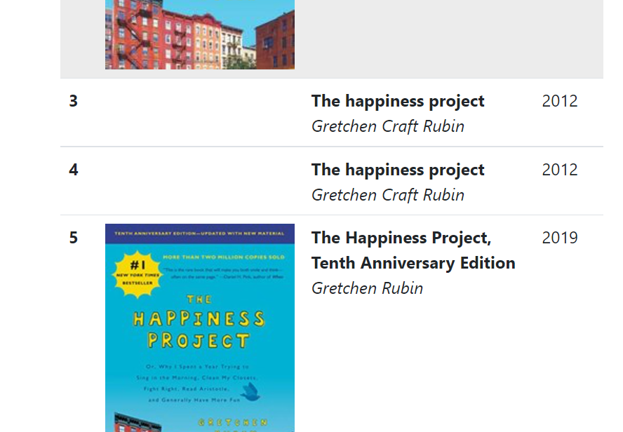

Slide 8
atomic habits "james clear“
Happiness project Gretchen
See when you slow down haemin
Midnight library matt haig
Breathe becomes air Paul Kalanithi
2 API
Image
Date
Bootstrap
sort

